Slide 1
CSE 102 Introduction to CS and Programming Methodology Lab
Department of Computer Science and Engineering
University of Asia Pacific

Slide 2
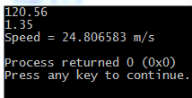
Today’s experiments - 1
Write a program that will take a floating point number which indicates the distance covered by a bus (in Km). Next another floating point number will be given, which is the time take by the bus (in Hours). Print the speed of the bus in meter/second.

Slide 3
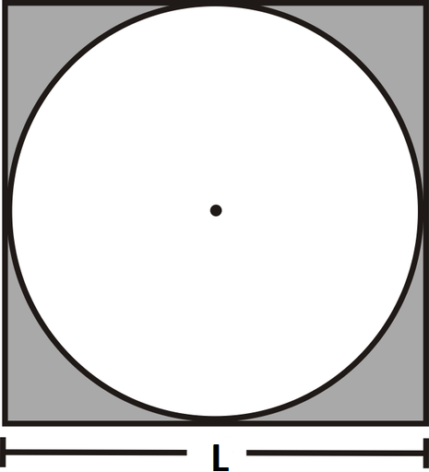
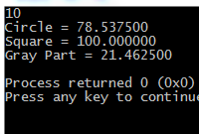
Today’s experiments - 2
Write a program which will take L as input and print the area of circle, square and the gray part.

Slide 4
Today’s experiments - 3
Write a program which will take two integer numbers as input and swap their values.
Input | Output
3 5 | 5 3

Slide 5
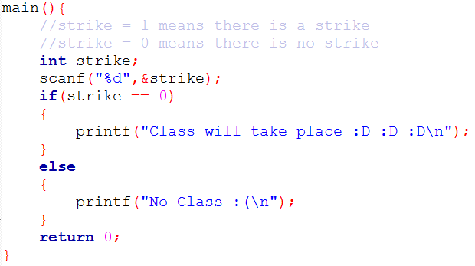
Example

Slide 6
Today’s experiments - 4
Write a program which will take an integer number as input and print whether the number is Positive / Negative / Zero.
Input | Output
5 | Positive
0 | Zero
3 | Negative

Slide 7



Today’s experiments - 5
Write a program that will take an integer and determine whether the number is a perfect square or not.

Slide 8
Today’s Experiment - 6
Create a simple arithmetic calculator. The program will request the user to enter a number, an operator and another number. It should then carry out the specific arithmetic operation: addition, subtraction, multiplication or division of two numbers. Finally display the result.
Input | Output
3 + 3 | 6
2 – 2 | 0
2 * 4 | 8
33 / 2 | 16.50

Slide 9
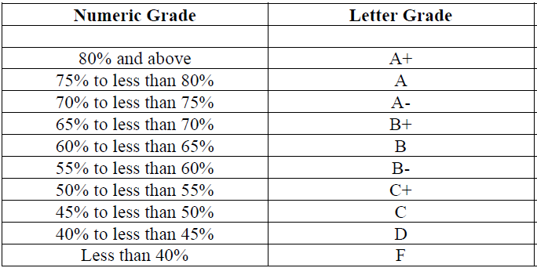
Today’s experiments - 7
Take an integer number as input, consider it as an exam mark and print the corresponding Letter Grade.
Input | Output
81 | A+
39 | F
62 | B

Slide 10
Today’s experiments - 8
Write a program that will take four integers as input and print them in ascending order of their values.
Hint: swap
Input | Output
50 1 3 23 | 1 3 23 50

Slide 11
Bonus
Write a program that will take a seven digit integer and reverse the number. Only printing won’t be enough, you need to reconstruct the reversed number in a variable.
Then check if the number is a palindrome. (A palindrome is a number which looks the same from both ways)
Example: 12321 is a palindrome, 1232 is not

Slide 12
Notice
Lab Test: 24 June
Topics:
MS Word
MS Excel
C Programming Language:
Input / Output
Expressions, Calculations
If-Else

